Slide 1

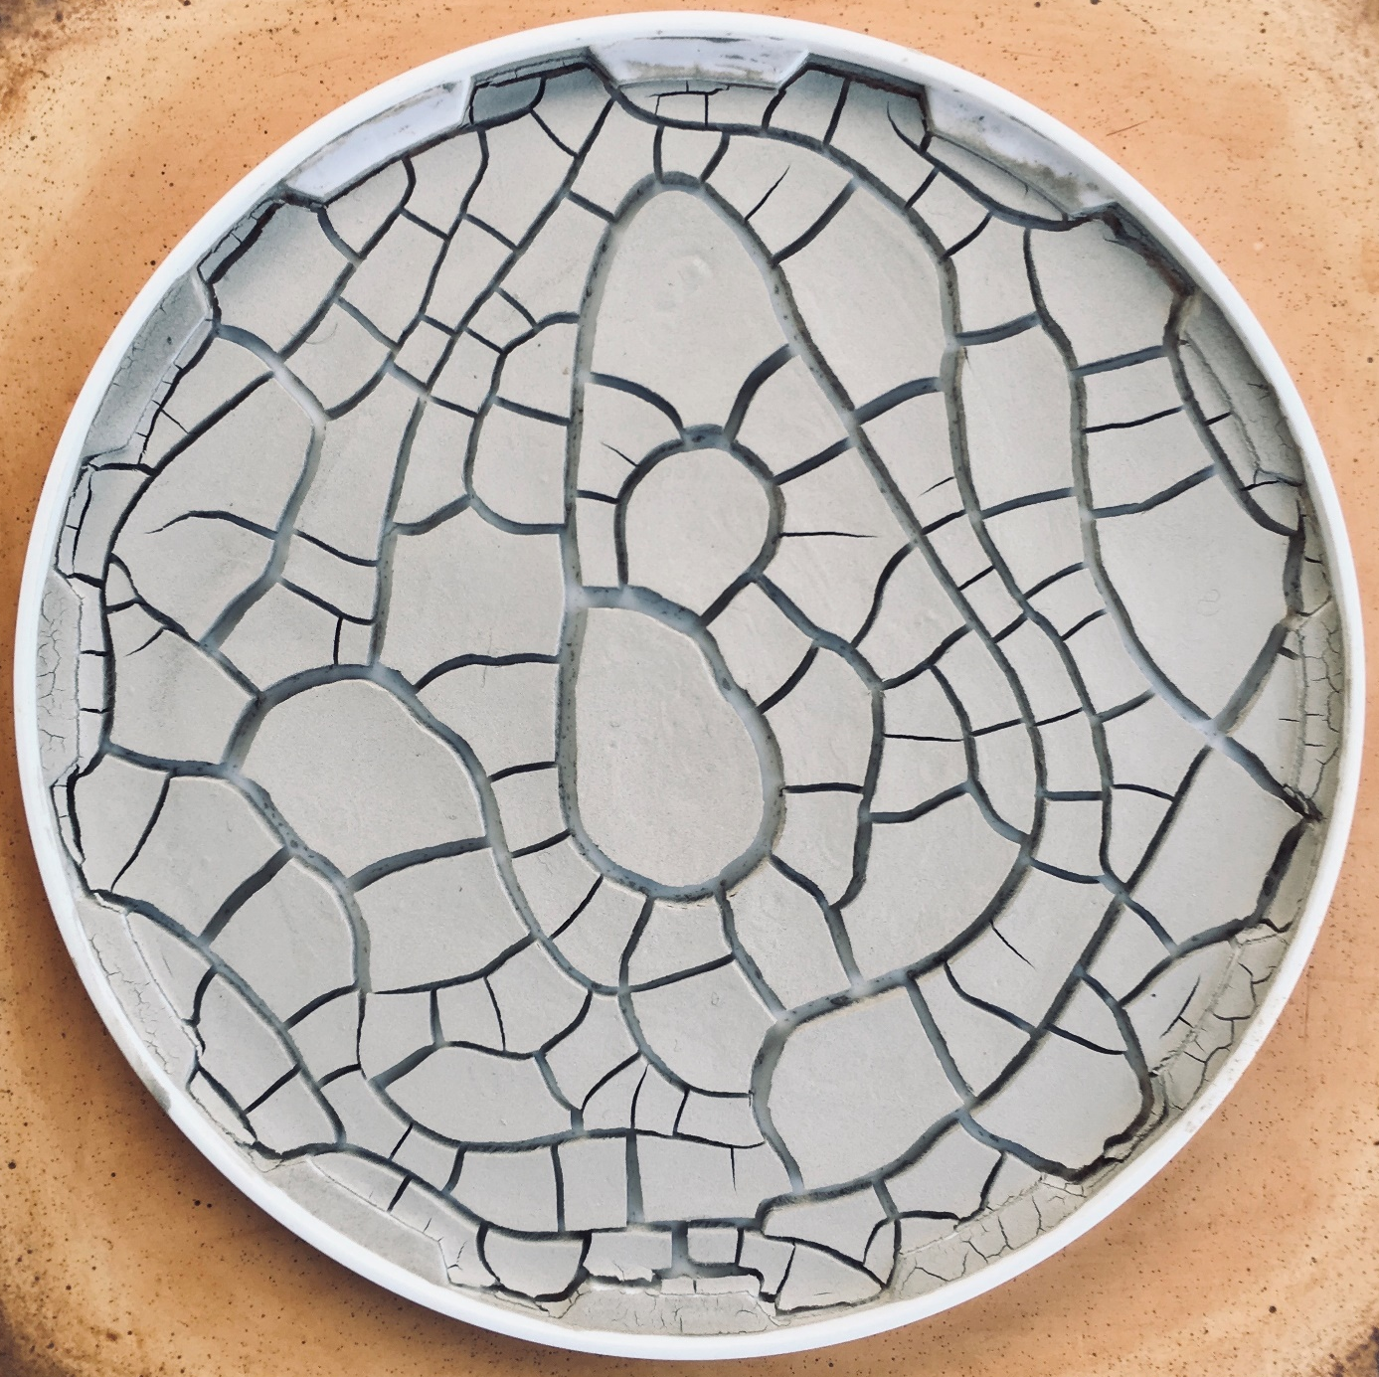
Notes:
Photo © Rupert Brakspear. Website: www.rbrakspear.com
Instagram: brakspearceramics

