Slide 1
Changing Geographies: Using the front cover of Primary Geography

Slide 2
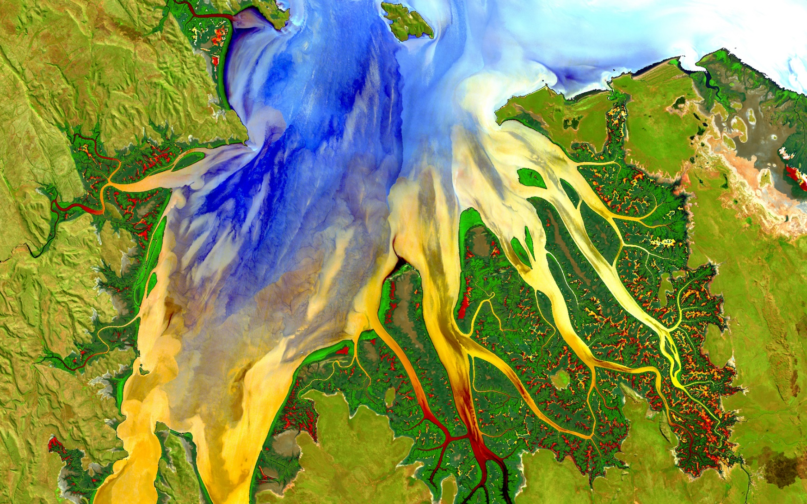
What can you see?
What is happening here?
Where might this be?
Notes:
Image © NASA

Slide 3
The image, captured by the Landsat 8 satellite, shows the view over Western Australia on May 12, 2013. The image shows rich sediment and nutrient patterns in a tropical estuary area and complex patterns and conditions in vegetated areas.
What do the words in bold above mean? Write a glossary then label the image.
satellite
sediment
nutrient
tropical
estuary
vegetated

Slide 4
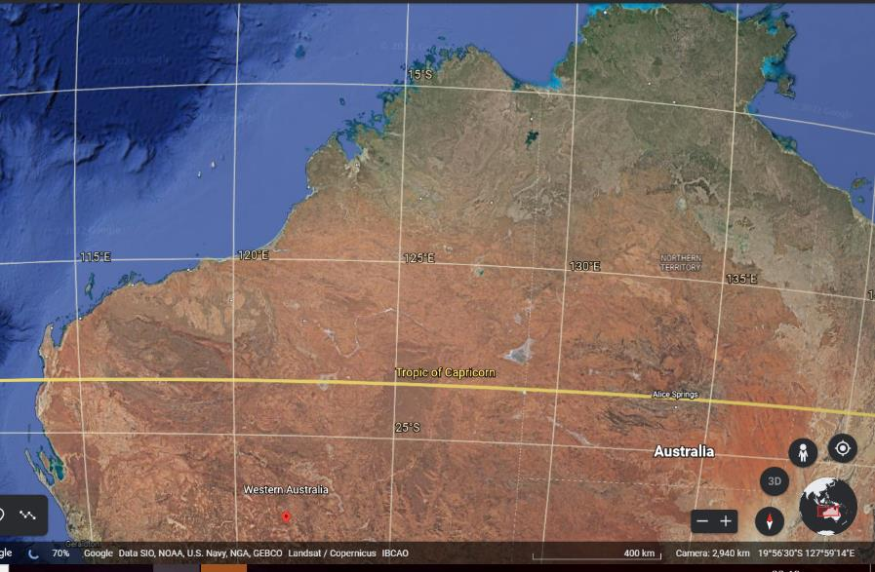
Use Google Earth to find a tropical estuary in Western Australia. Zoom in to look closely.
Notes:
Image © Google

Slide 5
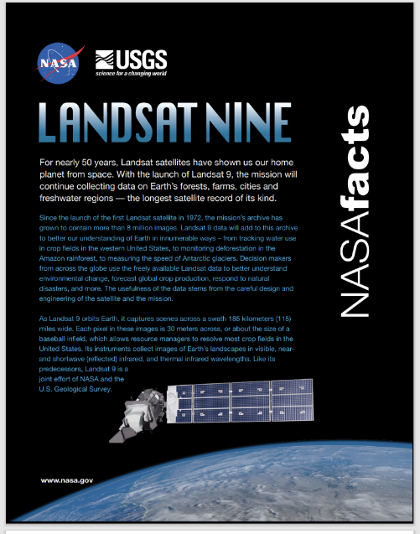
Click on the image here to view the Landsat 9 Fact Sheet.
What is Landsat Nine?
What does it do?
Why does it collect this data?
Notes:
https://landsat.gsfc.nasa.gov/wp-content/uploads/2019/09/L9-factsheet-web.pdf

