Slide 1
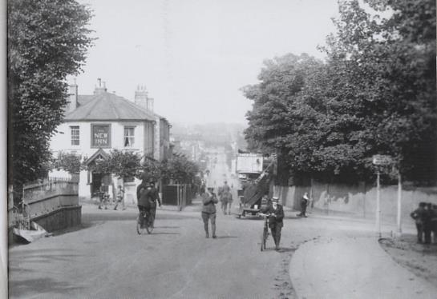
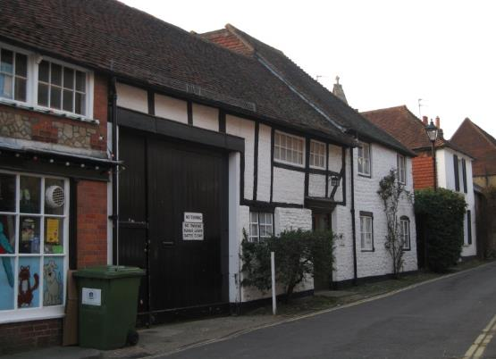
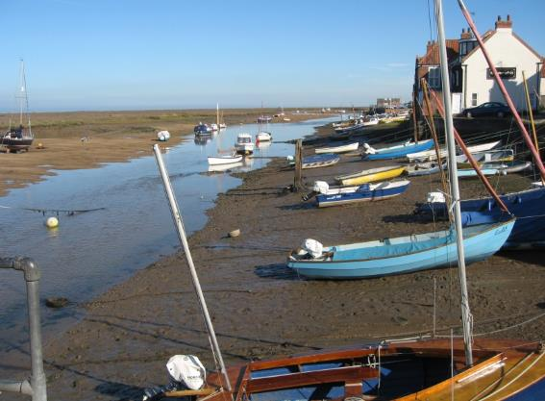
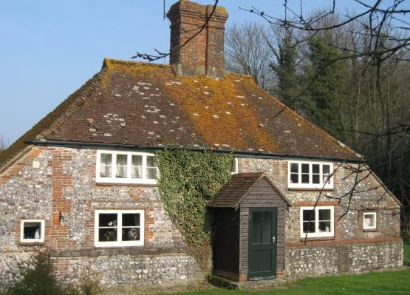
Settlement
Notes:
Source: Primary Geography Summer 2019 www.geography.org.uk
All photos © Paula Richardson

Slide 2
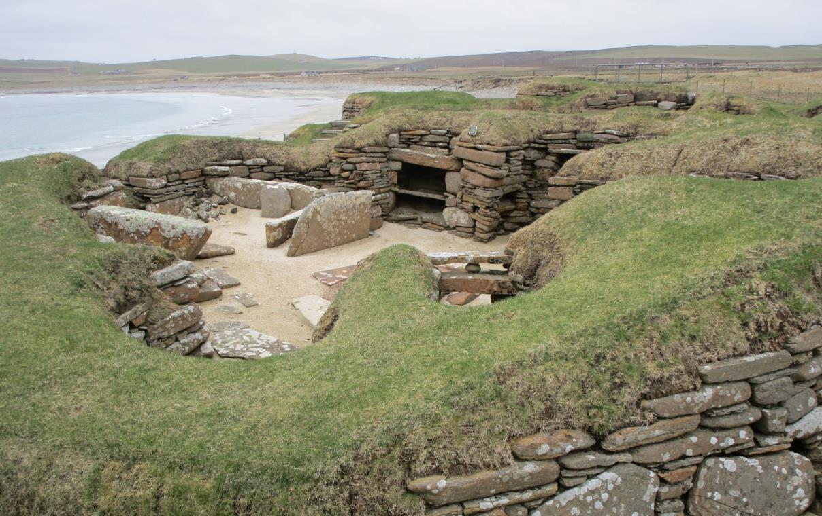
Notes:
Many of the Early invader settlements built quite sophisticated homes even in remote places but took care to use the natural landscape to best advantage to shelter from the storms and bad weather especially in winter. This settlement was in Skara Brae in the Orkney Islands

Slide 3
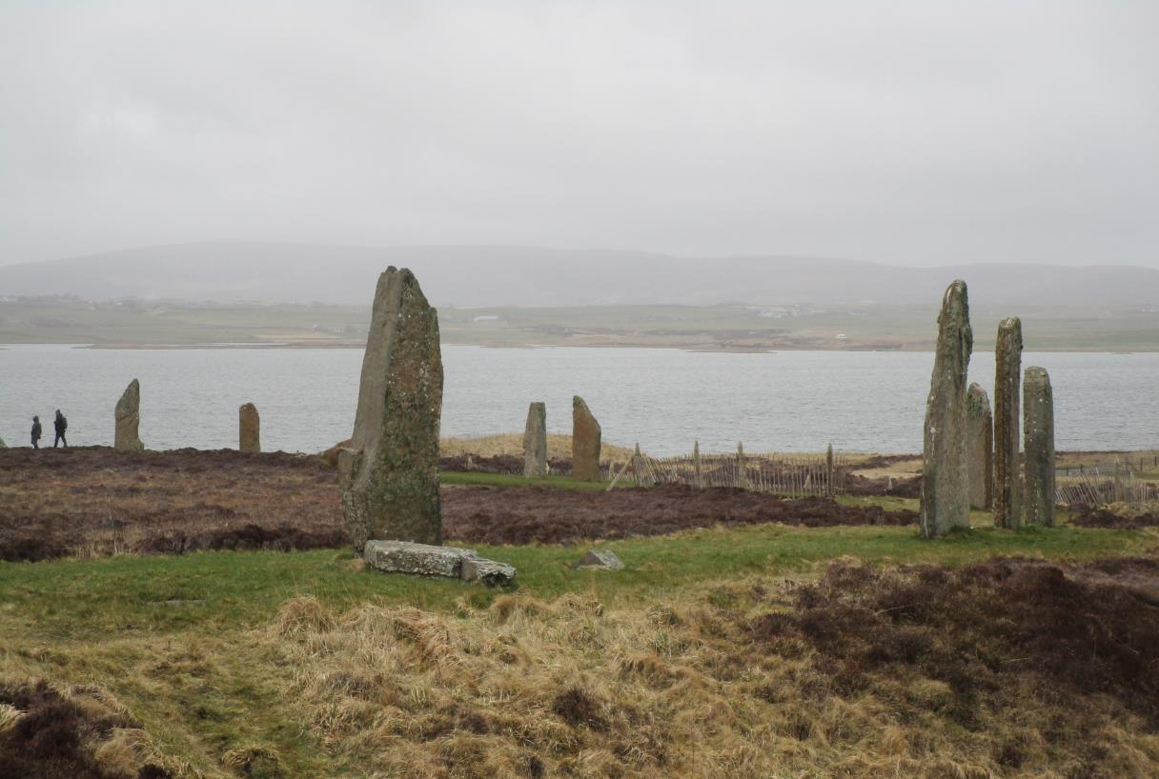
Notes:
The Ring of Brodgar in the Orkney Islands is an example of a Neolithic settlement similar to others found further south. Its’ true use can only be guessed at but it could be a place of rituals or for observation of the seasonal equinox and solstice.

Slide 4
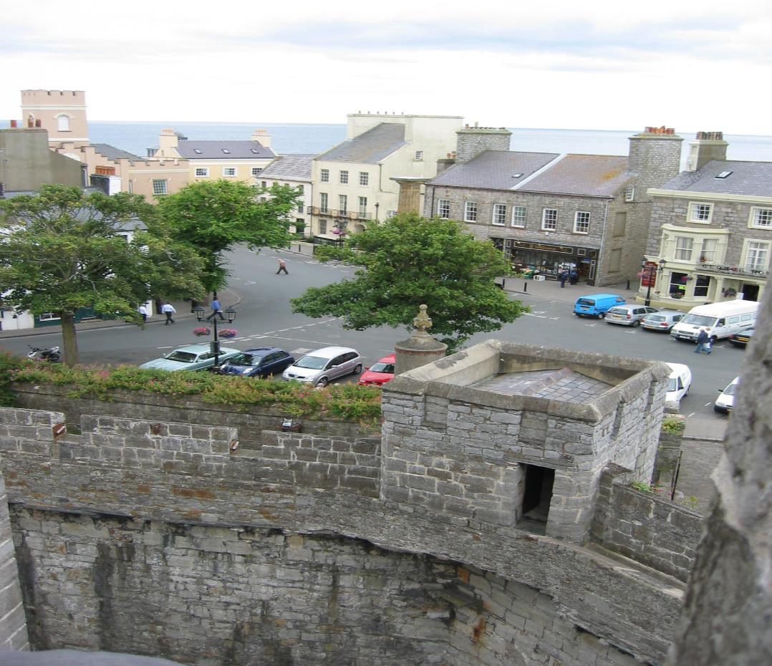
Notes:
Peel Castle on the Isle of Man where the town grew up around the castle for protection.

Slide 5
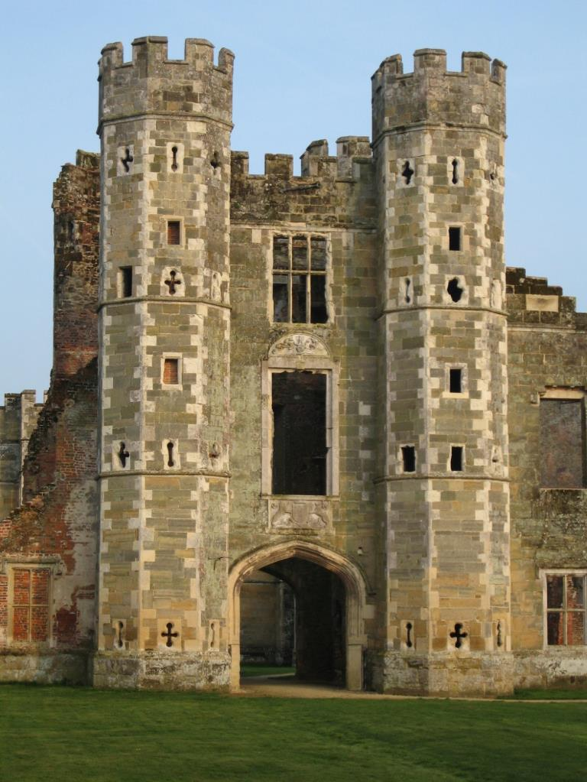
Notes:
After the Norman conquest castles and defensive buildings were constructed of stone which meant they could withstand attack and lasted for many centuries

Slide 6
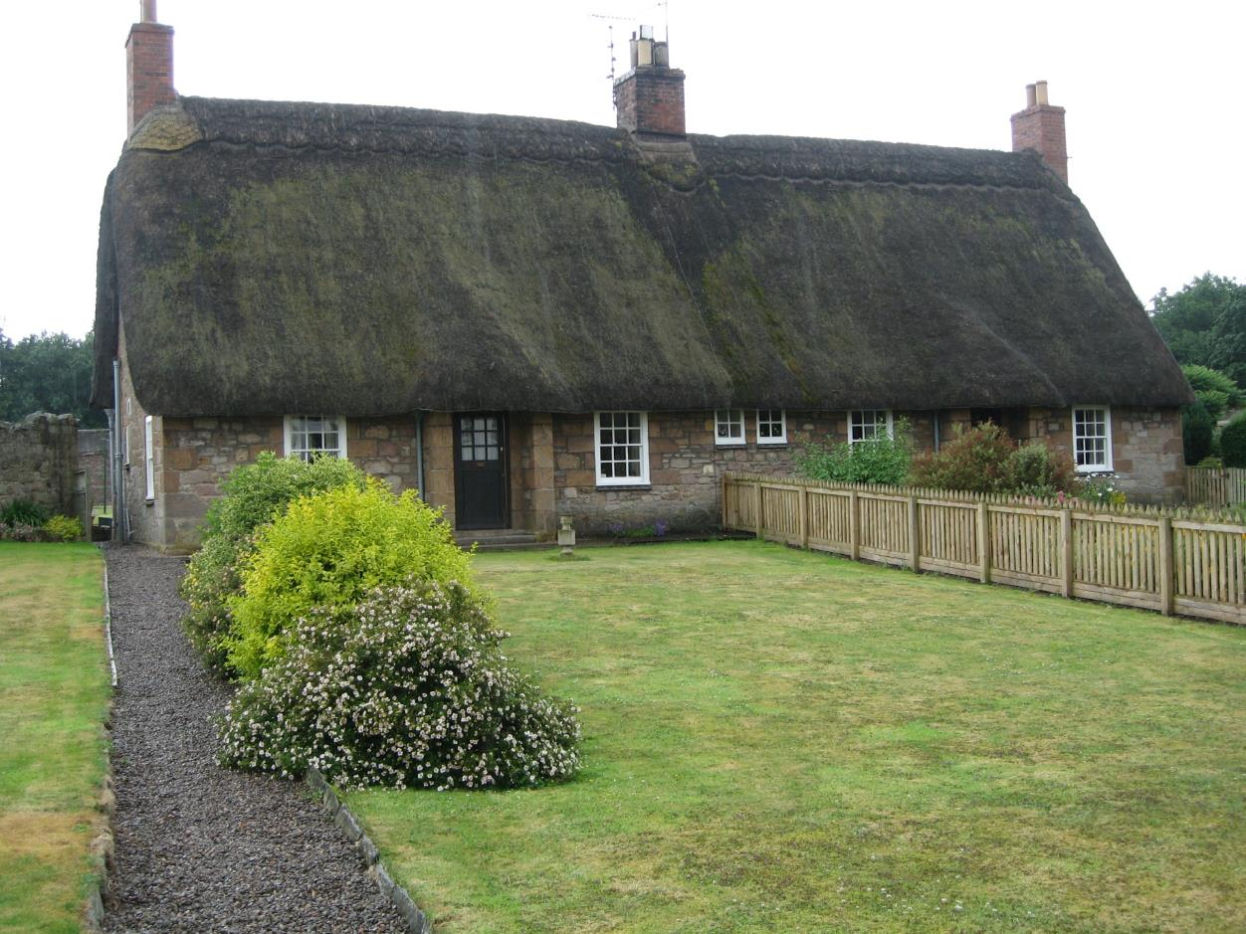
Notes:
Medieval houses were built using local materials which might be stone, flints or wattle and daub ( plaster on a wooden framework.) Thatching used local straw or reeds. Windows were small to keep the heat in and cold out. Many houses would not have had any type of glass as this was very expensive.

Slide 7
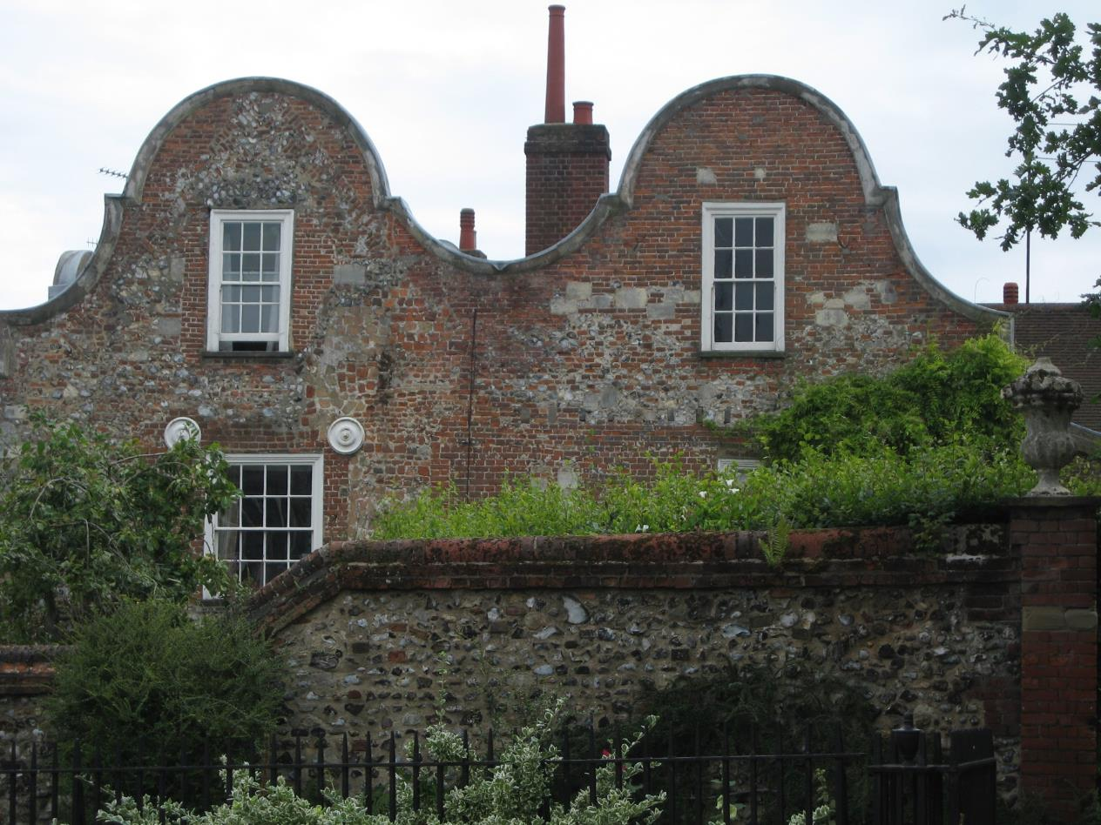
Notes:
Houses were often influenced by new settlers such as the Dutch who brought their distinctive roof style to Norfolk houses many of which were built of local flint and brick.

Slide 8
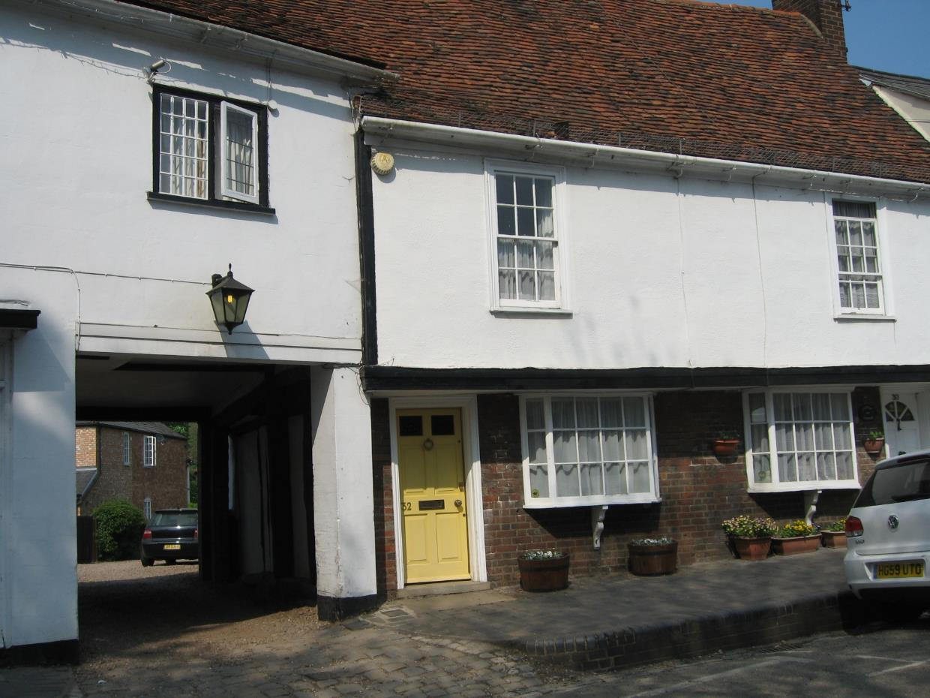
Notes:
A typical house from the 16 and 17 Centuries – small windows and overhanging second storey with a coach and horse entrance to a courtyard behind. This might have been a merchant’s house or even an inn. Sometimes the foundations were not good and this led to some subsidence of the houses over time.

Slide 9
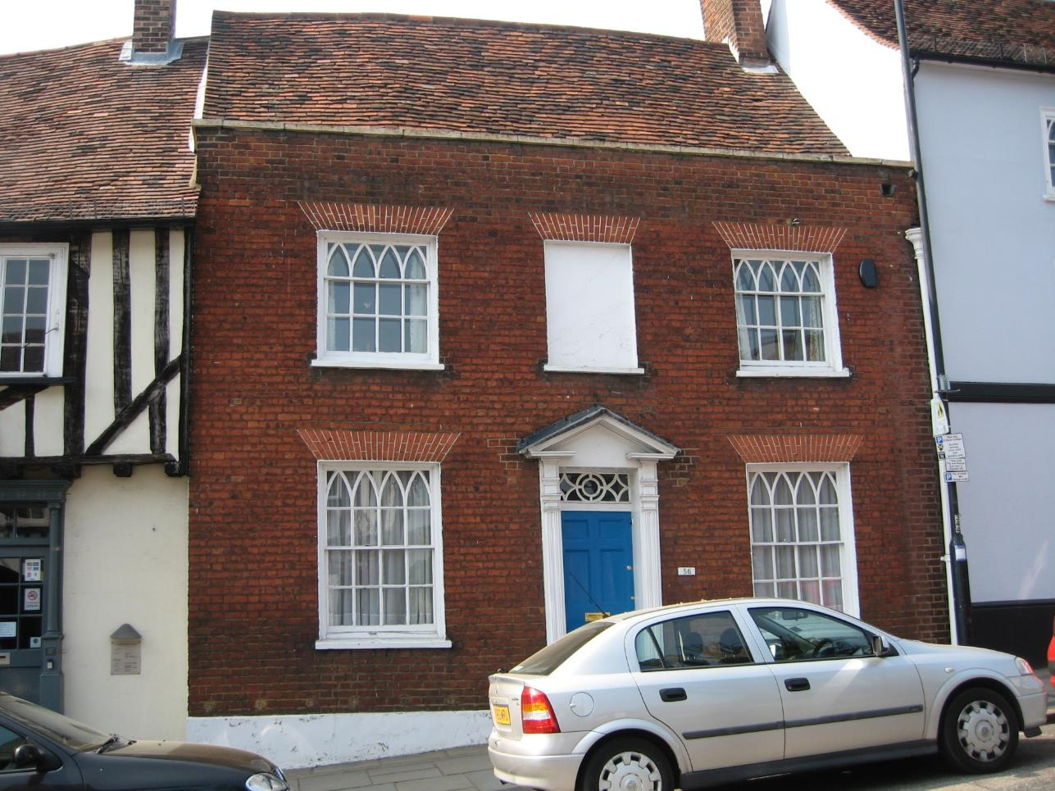
Notes:
This is an example of a Georgian front which has been added to the front of a Tudor building similar to the one on the left thus making it very fashionable without building it all from scratch! A window tax meant that many houses covered up their windows to avoid it.

Slide 10
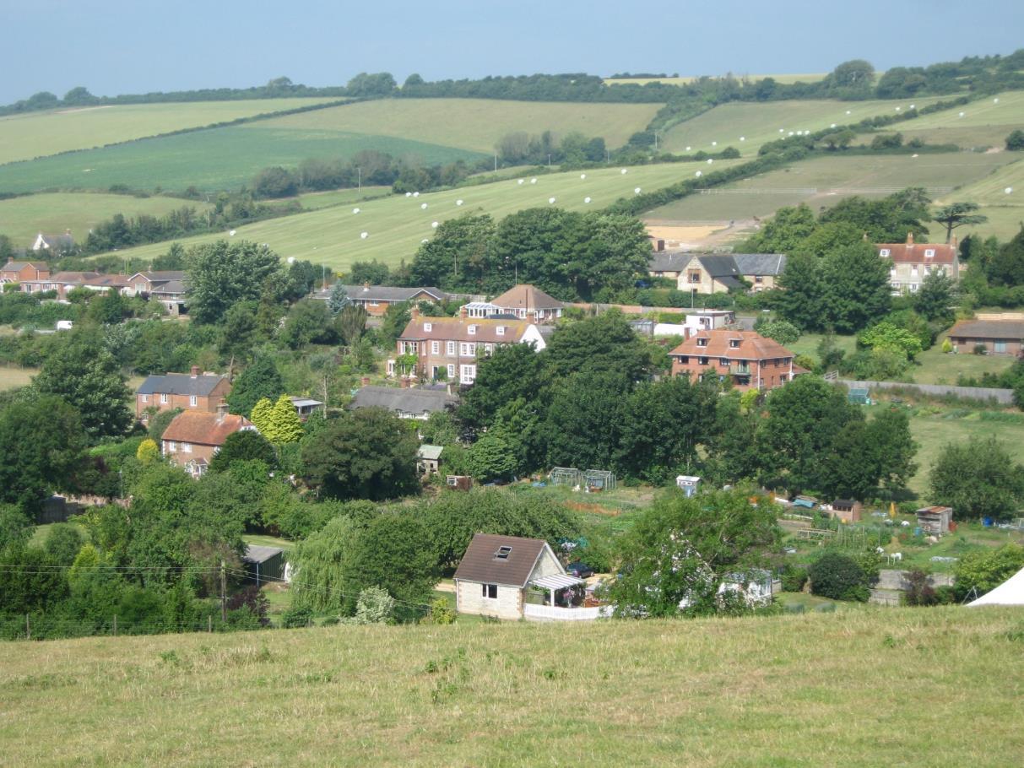
Notes:
Prior to the Industrial Revolution many settlements were essentially farming communities sometimes with small local industries based on wool, meat, ironwork and looking after livestock.

Slide 11
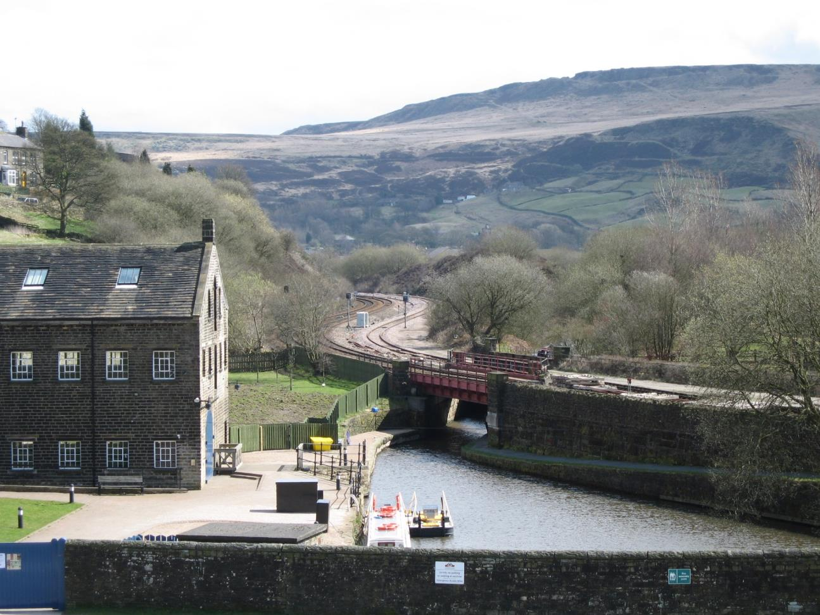
Notes:
The growth of the canals and railways brought industrial development to many parts of Britain and people moved in large numbers from rural settlements to work in the growing number of factories. Industrial Britain began to take shape.

Slide 12
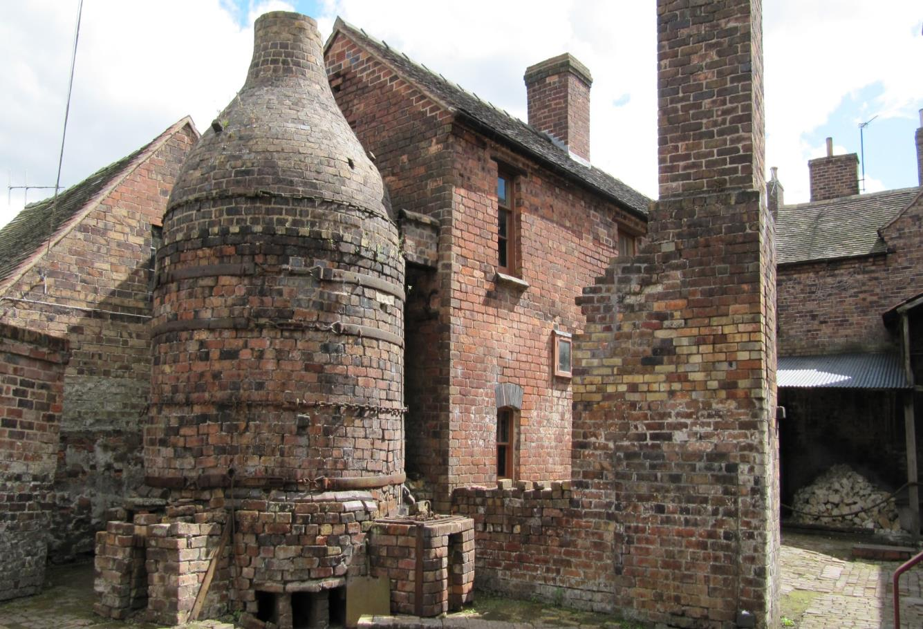
Notes:
The potteries in Staffordshire grew rapidly in the Industrial Revolution using local clay and coal as raw materials.

Slide 13
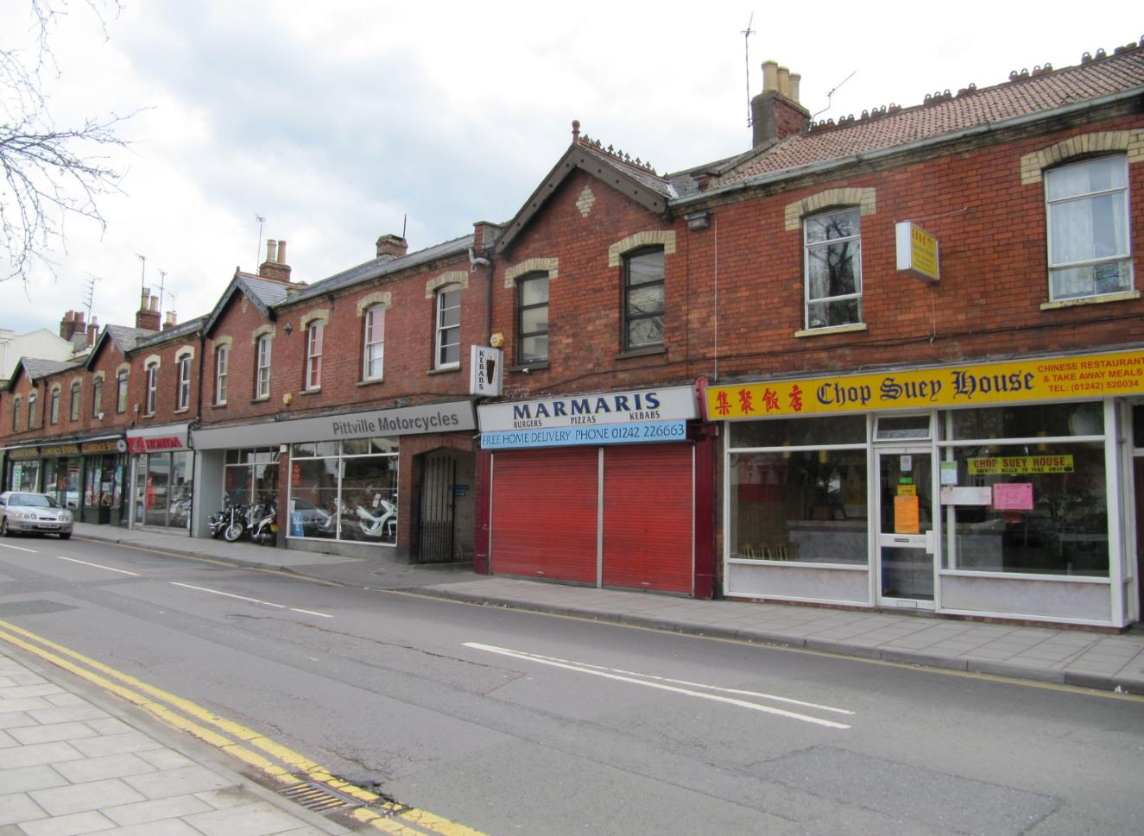
Notes:
Towns during the Industrial growth were characterised by streets of Victorian and Edwardian terraces which housed the industrial workers. These are now often converted so the ground floor provides services for the local area of town.

Slide 14
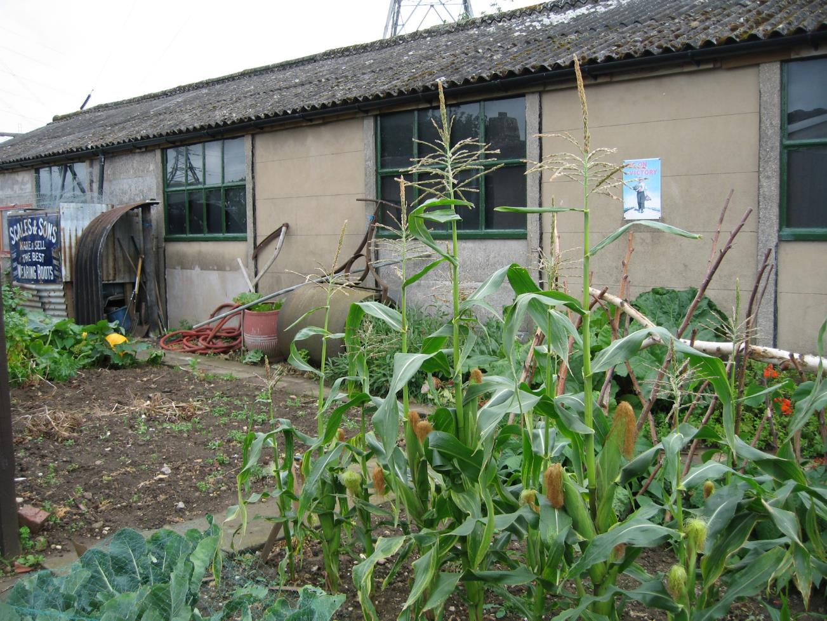
Notes:
After WW2 prefabs were built to house those families who had lost their homes during the bombing raids mostly over industrial cities.

Slide 15
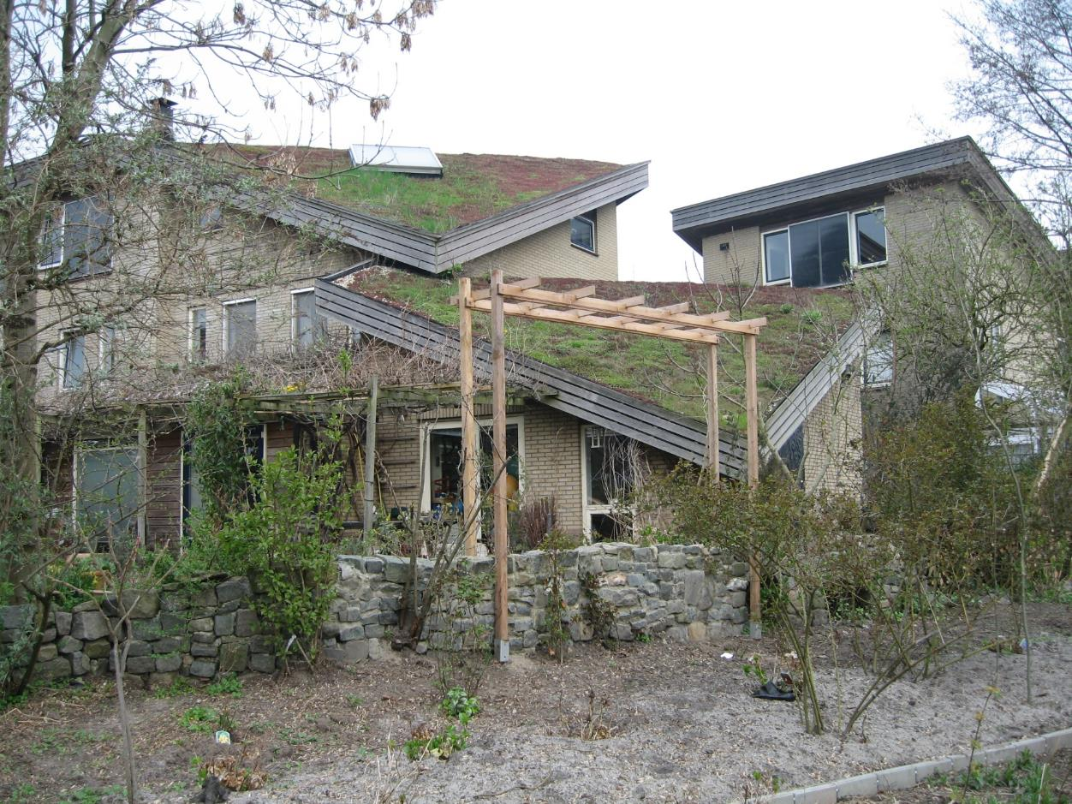
Notes:
The future = eco friendly houses with grass on the roofs often using solar energy and other renewable resources.

Slide 16
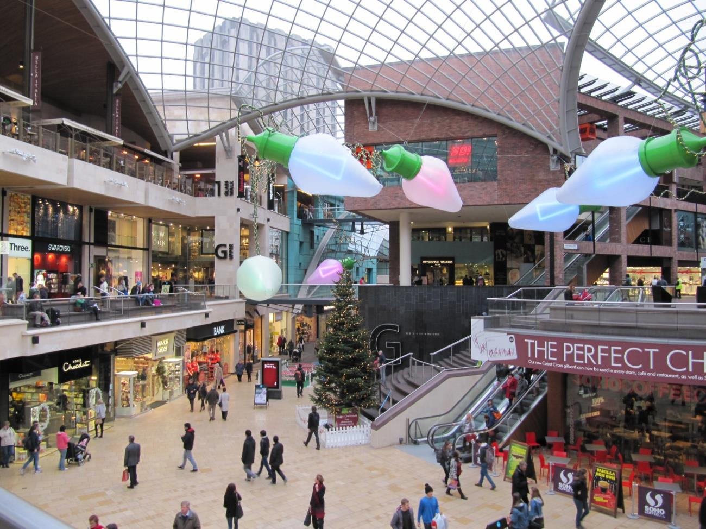
Notes:
The future- the development of shopping malls such as this one in Bristol where shops, entertainment and eating outlets can all be found under one roof. How does this affect other shops in the High Street?

Slide 17
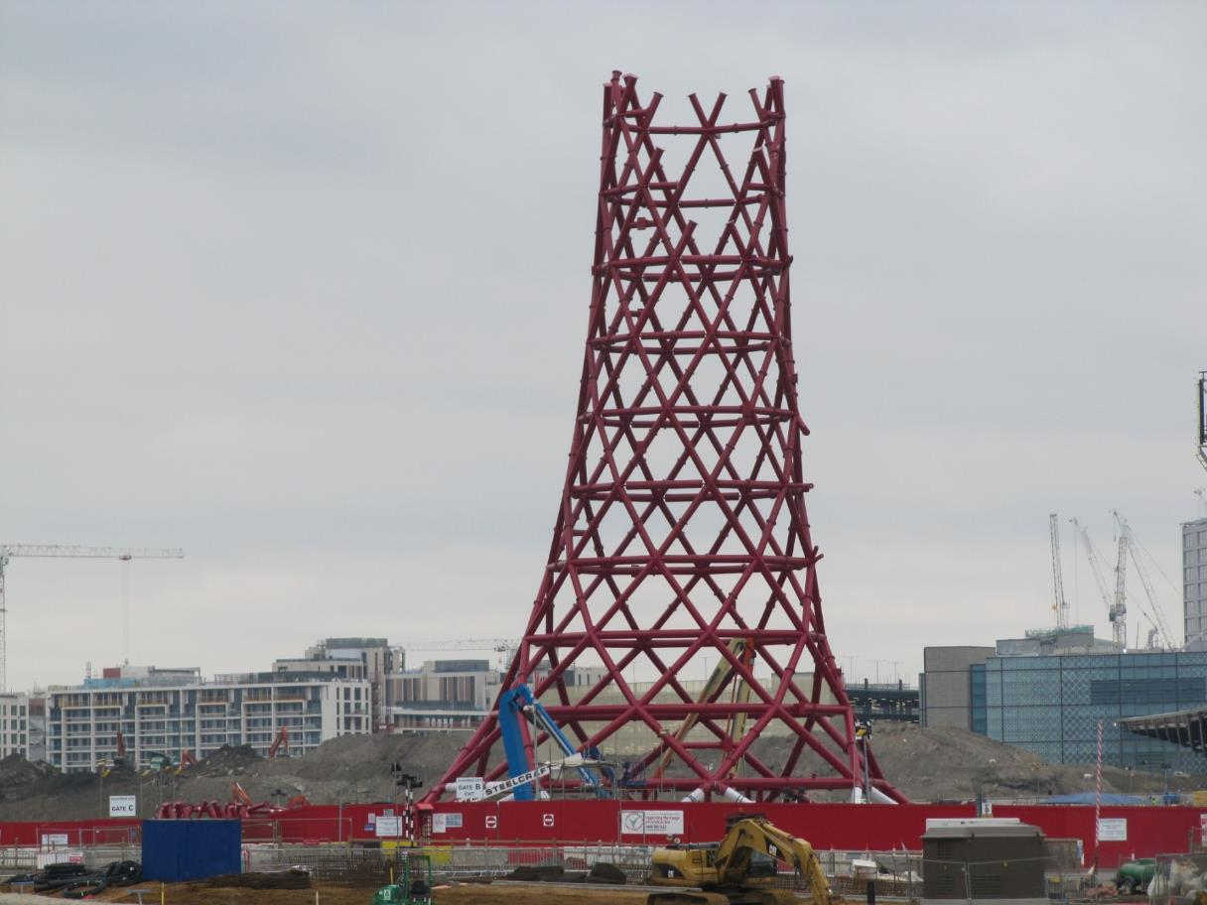
Notes:
The Future – a brownfield site cleared to construct the London Olympic Park surrounded by dense housing and a complex infrastructure.

Slide 18
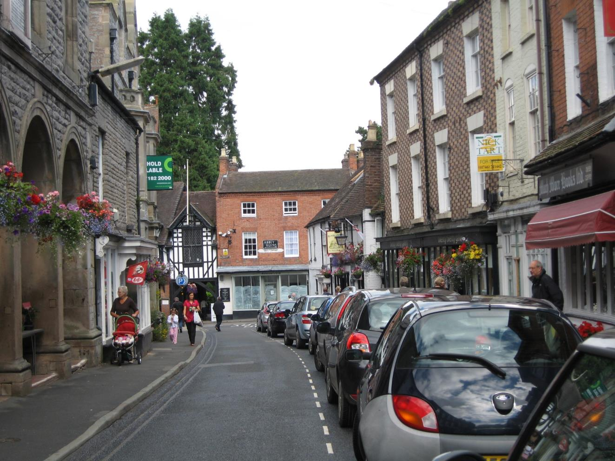
Notes:
The future – a classic town centre high street showing buildings from several centuries adapted to modern life but also indicating the modern problem facing everywhere today – traffic. .

