Slide 1
The Primary Geography Interview:
Amy and Ella Meek,
Founders of Kids Against Plastic

Slide 2
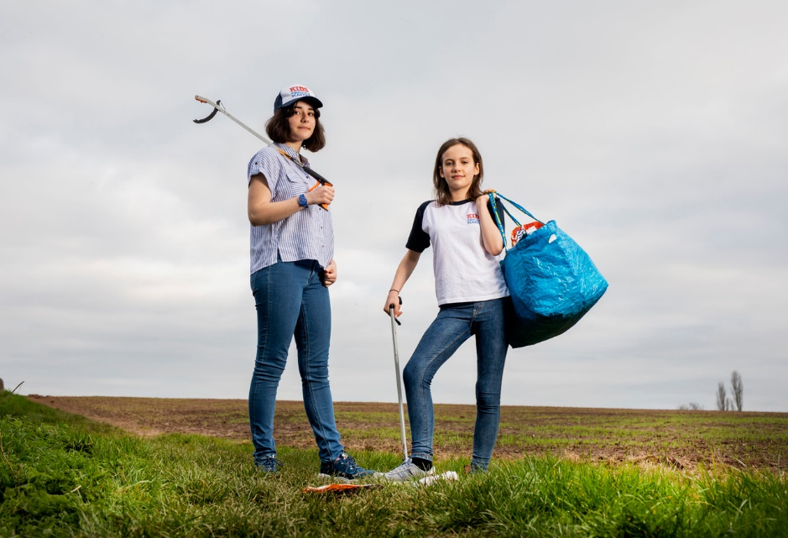
Question 1. What does geography mean to you?
Watch Amy and Ella answer here

Slide 3
Question 2. What is your most memorable experience of geography at school?
Watch Amy and Ella answer here

Slide 4
Question 3. What is your favourite place?
Watch Amy and Ella answer here

Slide 5
Question 4. What is your favourite geographical activity?
Watch Amy and Ella answer here

Slide 6
Question 5. How important is geography?
Watch Amy and Ella answer here

Slide 7
Question 6. What have you learnt from geography?
Watch Amy and Ella answer here

Slide 8
Inspired by the UN’s Global Goals and concerned by the impact of single-use plastic on the environment, Amy and Ella launched the Kids Against Plastic campaign. This group has three key aims:
Raise awareness and understanding of the problems caused by plastic misuse
Encourage and support others to become ‘Plastic Clever’ and reduce single-use plastics
Empower children and young people to believe they can make a difference.
Find out more at: https://www.kidsagainstplastic.co.uk/

